Slide 1

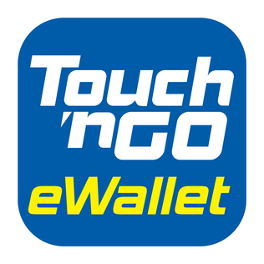
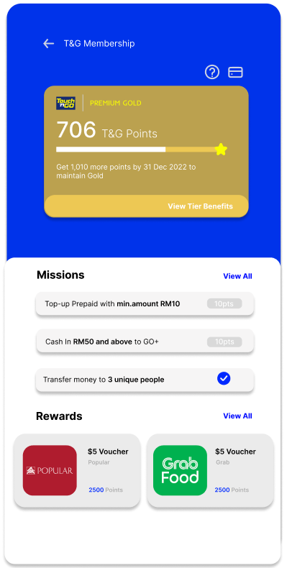
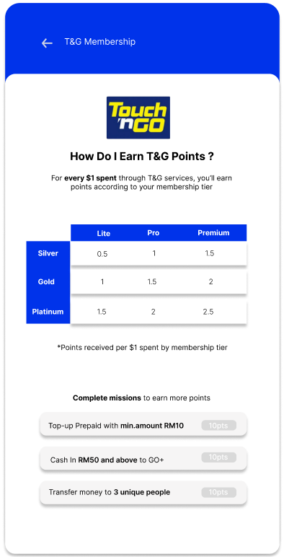
TNG Loyalty Programme
Keep track of your T&G Points and membership Tier
1
Upgrade your account and membership tier to earn more points / $1 spent
3
Redeem rewards with your T&G points
Complete missions to earn additional points
2
4

Slide 2
Problem Statement
The lack of incentive to use TNG e-wallet as cashless payment method has rendered its weak status among the competitors. To retain the current users, a sense of continuous intention to use e-wallet through loyalty programme is of paramount importance.

Slide 3
Market/Consumer Needs
Loyalty Program
Program which offers points with every dollar spent. The consumers need incentives to spend continuously using Touch & Go eWallet. Points accumulated can be used to exchange for gift vouchers and merchandise of liking.
The market and businesses can also offer vouchers and discounts through the loyalty program and attract more users to purchase their items or services

Slide 4
Value Proposition
Exchange points for gift/cash vouchers
Gain creators
Earn points
TNG Pay Challenge
Progress bar
Get vouchers
Win prizes
Gains
Premium platinum member stand a chance to win company shares
Higher point per dollar at higher level
Consumer loyalty reward
Loyalty programme
Job-To-Be-Done
Redeem merchandise with points earned
Earn company shares
Products & services
Earn rewards
Maximise benefits from being loyal to one e-wallet
Switching e-wallets frequently for different loyalty benefits provided
Check-in strike rewards
Loyalty program to reward long term users
Comprehensive reward system
Pains
Lack of incentive for long term usage
No rewards for patronizing
Daily check-in for points/gifts
Pain relievers
Unattractive check-in rewards

Slide 5
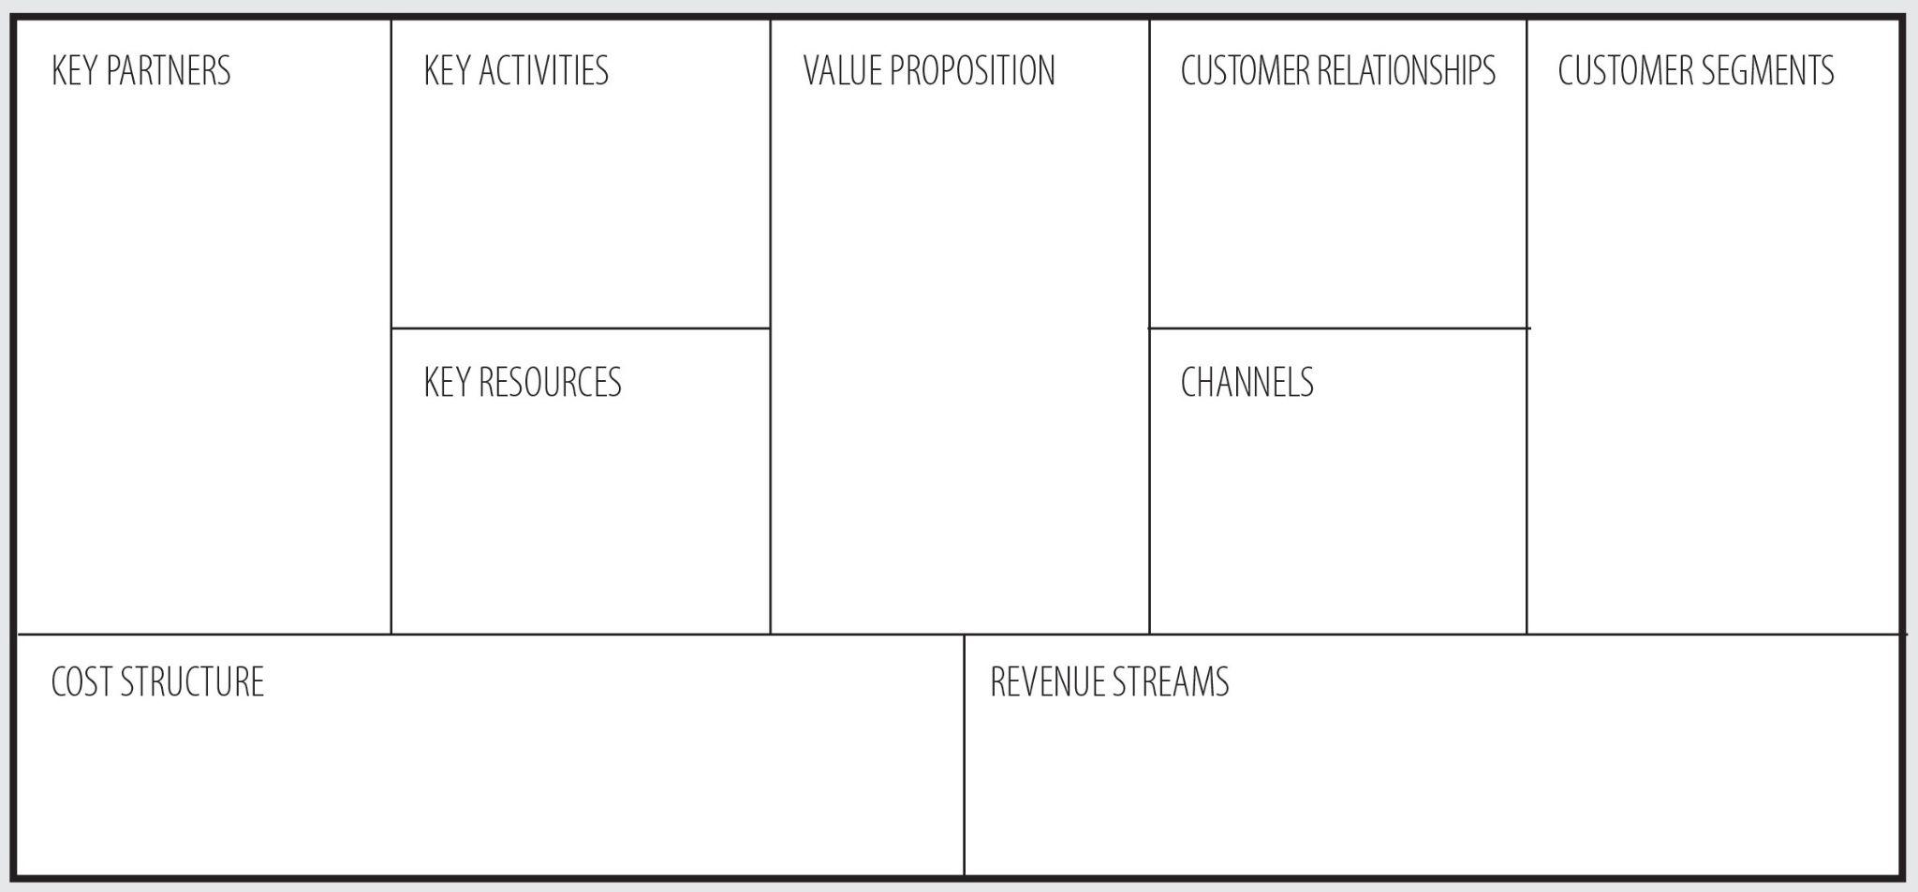
Business Model
Company providing gift or cash vouchers
Marketing
Loyalty programme
Earn loyalty points per dollar spent
Working adults
Platform Development and maintenance
Customer Support
Consumers who rely on cashless payment
Company providing merchandise to be exchanged by points
Exchange gift vouchers/merchandize with loyalty points
Discount/ Voucher
TNG E-Wallet User
TNG e-wallet platform
Attractive check-in strike gifts
TNG e-wallet app
Human Resources
TNG membership campaign
Loyalty reward
Marketing
Increase Customer Base, e.g. referral
Increase in apps spending
Platform Development and maintenance
Enhance user engagement

Slide 6
Closing Remarks
The emerging competitors which provide e-wallet service has weakened TNG e-wallet status today. Thus, loyalty program which allows accumulation of points through long term use and the redemption of gifts and vouchers from loyalty points will be useful to retain the consumers in the continuation of using our service.

